Slide 1
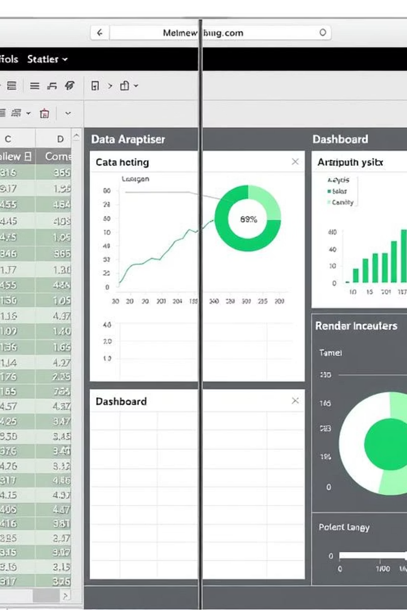
Power BI vs Excel – When and Why
Choosing the Right Tool for Data Analysis

Slide 2
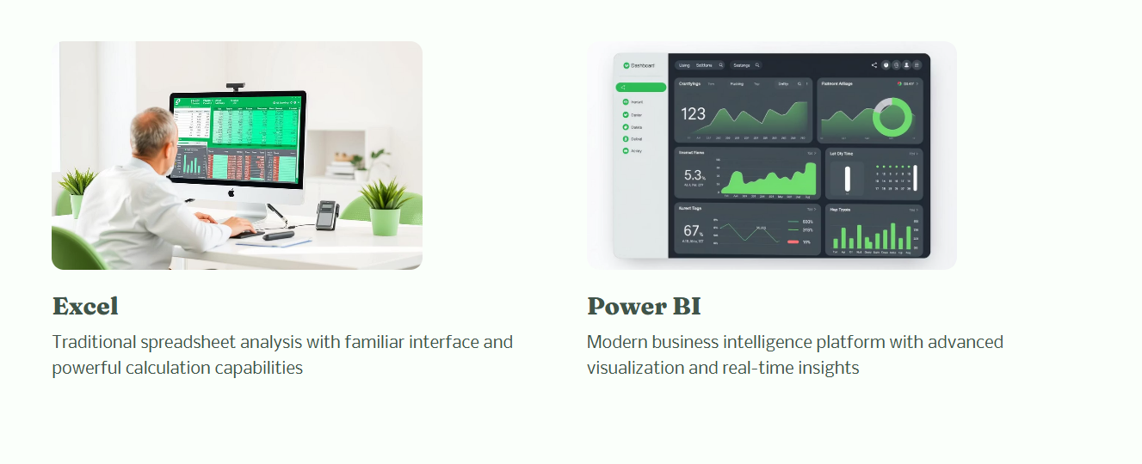

Slide 3

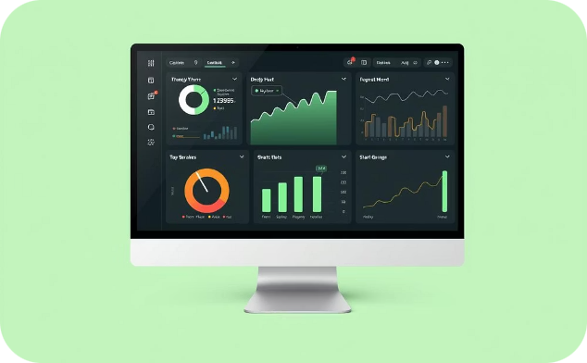

Why This Comparison?
Understanding when to use Excel versus Power BI is crucial for maximizing productivity and extracting deeper insights from your data.
Excel: Powerful & Ubiquitous
Power BI: Scalable & Interactive
Boost Productivity & Insights
A widely used spreadsheet tool, Excel is known for its versatility in data manipulation and calculations.
Designed for advanced, interactive data analytics, Power BI excels at visualizing and sharing large datasets.
Choosing the right tool for the right task streamlines workflows and enhances decision-making.

Slide 4
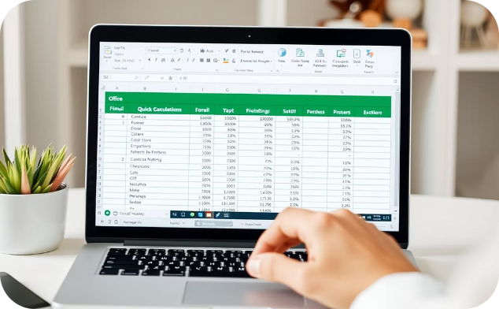
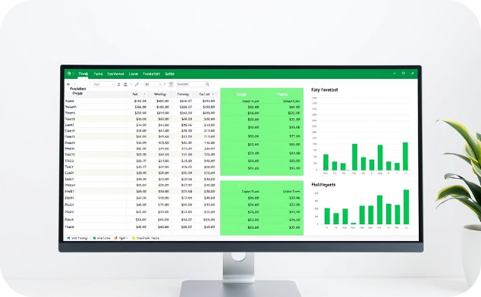
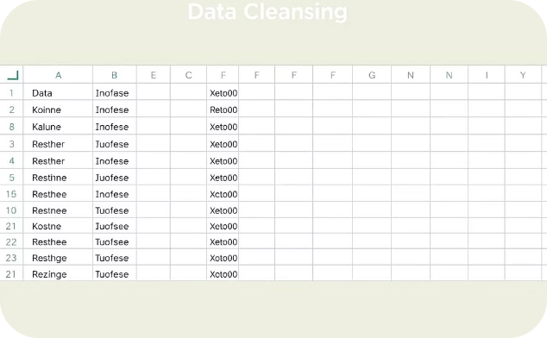
Use Cases – When to Use Excel
Quick Calculations & Ad-hoc Analysis
Financial Modeling & Budgeting
Small Dataset Manipulation
Ideal for datasets under 1 million rows. Simplifies data cleanup, sorting, and filtering without specialized training.
Perfect for rapid data entry, formulas, pivot tables, and "what-if" scenarios with immediate results.
Preferred tool for custom financial templates, forecasts, and audit trails with cell-level control.

Slide 5

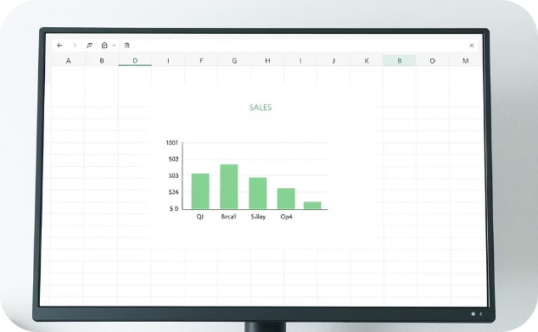

Limitations of Excel
Limited Performance with Large Datasets
Static Dashboards & Visuals
Collaboration & Sharing Gaps
Charts lack interactivity and dynamic filtering capabilities for deeper data exploration.
Excel struggles with millions of rows and complex calculations, becoming slow and unresponsive.
File sharing creates versioning issues and prevents real-time collaboration.

Slide 6



Use Cases – When to Use Power BI
Interactive Dashboards
Large Data Sets
Automated Reports
Power BI creates dynamic reports with filters and clickable charts that let users explore data easily.
It works well with millions of rows and connects to many data sources like databases, cloud services, and Excel files.
Power BI can update reports automatically and share them securely with teams, giving the right people access to the right data.

Slide 7
Quick Comparison
Feature
Excel
Power BI
Data Volume
Limited (~1M rows)
Handles millions easily
Visualizations
Basic charts & graphs
Advanced, interactive dashboards
Automation
Manual updates/formulas
Scheduled data refresh, auto-sync
Collaboration
Shared files (risk of errors)
Cloud-based, secure sharing
Ease of Use
Familiar to most users
Slight learning curve but scalable

Slide 8

Summary: Choose the Right Tool
Use Power BI when…
Use Excel when…
You need interactive, shareable dashboards.
You’re doing quick, manual analysis.
You’re working with large, diverse datasets.
You’re building financial or statistical models.
Automation and real-time updates matter.
The dataset is small and manageable.

Slide 9


